Slide 1
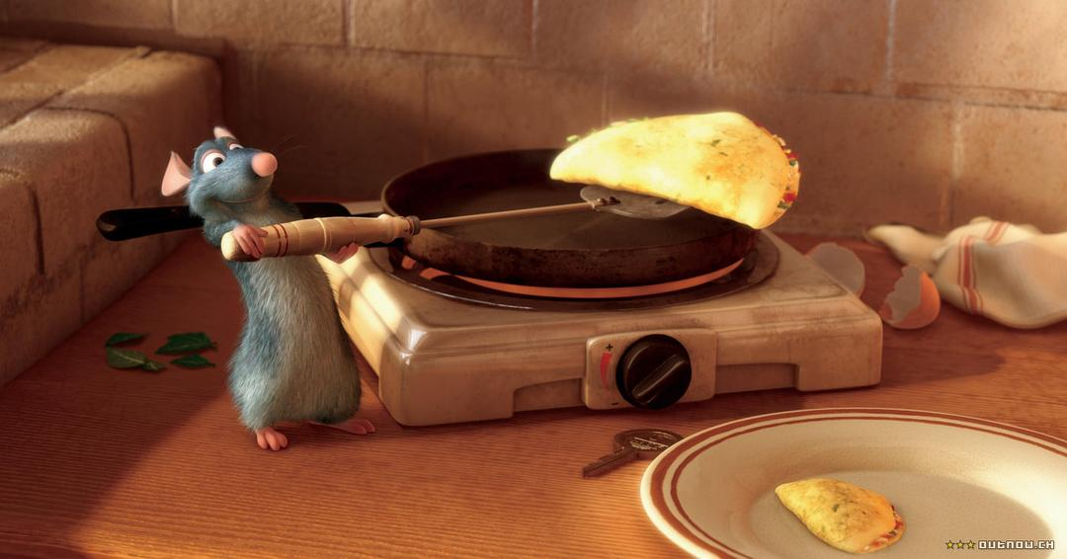
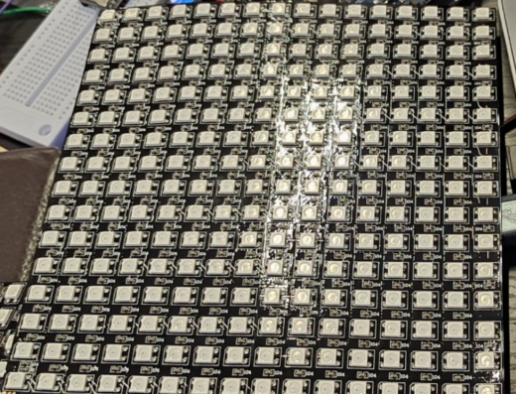
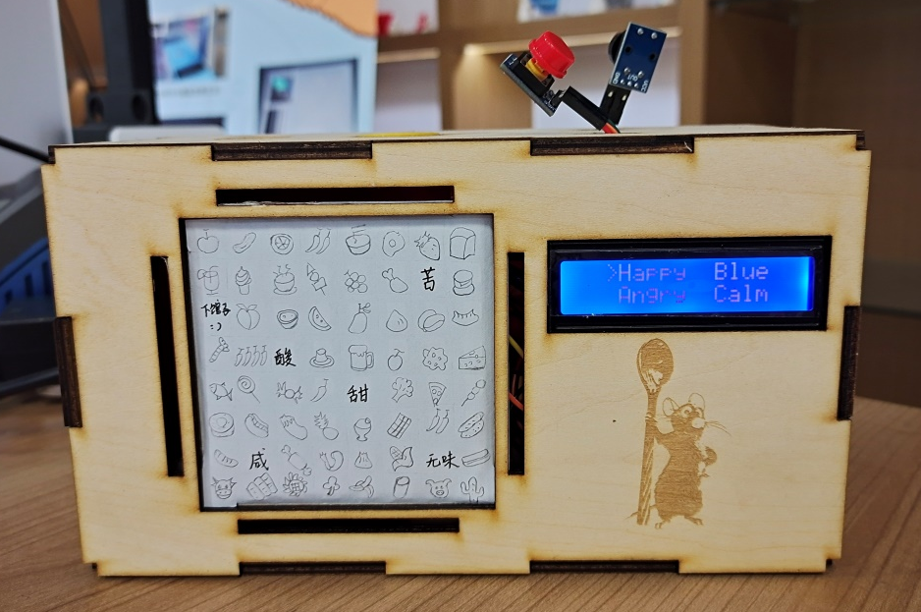
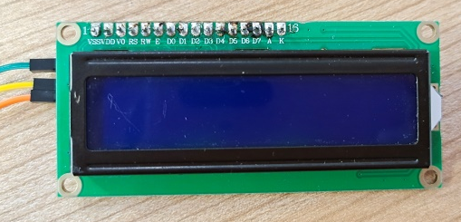
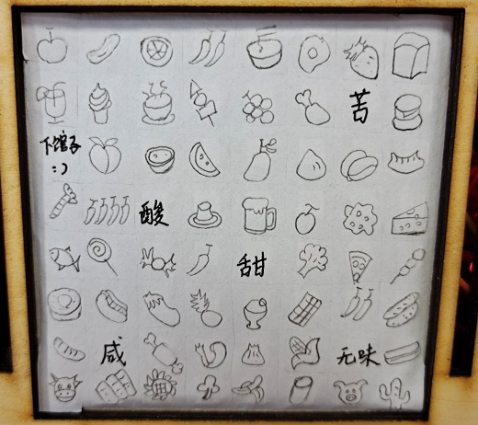
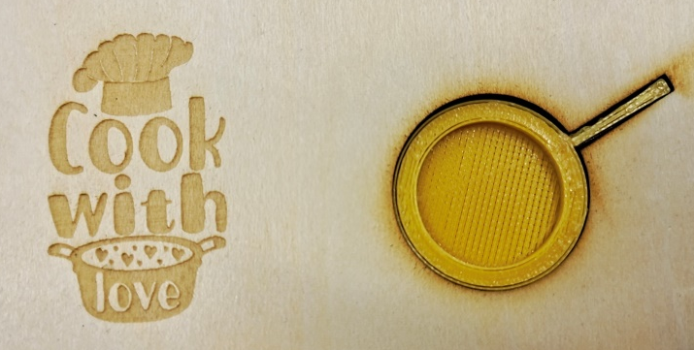
Your Mood Cooker
Shuran Wang（王舒然）
LED Matrix
▪ Light LEDs according to
your mood.
LCD Screen
▪ Choose your mood.
▪ Laser engraved logo
▪ 3D Printed pot
Self-painted Recipe
▪ Show different recipes.

Slide 2
Thank you!

